Slide 1

GU DEP ST
AE BUSINESS SOLUTIONS TECHNOLOGY CONFERENCE
NETWORK AUTOMATION IN THE AI ERA
DAN PLACEK
PRINCIPAL SOLUTIONS ARCHITECT
NETOPS PRACTICE LEAD

Slide 2
A model for thinking about automation
Know
Change
Prove
React
Govern
Serve
Intent and reality
Make the change
Will it work? Did it?
Act on events
Stay in policy
Let others self-serve
Source of Truth
Task Automation
Pre-Change Validation
Event-Driven Remediation
Lifecycle & Risk
Self-Service
State Collection
Declarative Config
Security Policy
ChatOps
Post-Change Verification
Diagnostic Automation
Docs & Reporting
Zero-Touch Provisioning
Compliance & Audit
Service Orchestration
Notes:
1:00–3:00. This is the map for the whole talk; every step later lights up part of it. Six families, named for the question each answers. Example tools, so the room can place what they already own. Know: NetBox, Nautobot, Infrahub; Oxidized, SuzieQ, gNMI collectors; IP Fabric, NetBrain. Change: Ansible, Nornir, Python; Arista AVD, Terraform, Cisco NSO; vendor ZTP; Itential, ServiceNow. Prove: Batfish, Containerlab, Cisco CML; pyATS, SuzieQ; Nautobot Golden Config, Forward Networks. React: Event-Driven Ansible, StackStorm. Govern: vendor PSIRT and EoX APIs; Tufin, AlgoSec, FireMon. Serve: ServiceNow, AWX surveys, Slack and Teams bots. Name boxes by outcome, not tool, so the map outlives the tools.

Slide 3
Automation is more than “scripts”
Know
Change
Prove
React
Govern
Serve
Intent and reality
Make the change
Will it work? Did it?
Act on events
Stay in policy
Let others self-serve
Source of Truth
Task Automation
Pre-Change Validation
Event-Driven Remediation
Lifecycle & Risk
Self-Service
State Collection
Declarative Config
Security Policy
ChatOps
Post-Change Verification
Diagnostic Automation
Docs & Reporting
Zero-Touch Provisioning
Compliance & Audit
Service Orchestration
Notes:
1:00–3:00. This is the map for the whole talk; every step later lights up part of it. Six families, named for the question each answers. Example tools, so the room can place what they already own. Know: NetBox, Nautobot, Infrahub; Oxidized, SuzieQ, gNMI collectors; IP Fabric, NetBrain. Change: Ansible, Nornir, Python; Arista AVD, Terraform, Cisco NSO; vendor ZTP; Itential, ServiceNow. Prove: Batfish, Containerlab, Cisco CML; pyATS, SuzieQ; Nautobot Golden Config, Forward Networks. React: Event-Driven Ansible, StackStorm. Govern: vendor PSIRT and EoX APIs; Tufin, AlgoSec, FireMon. Serve: ServiceNow, AWX surveys, Slack and Teams bots. Name boxes by outcome, not tool, so the map outlives the tools.

Slide 4
Automation & Risk Quantification
Read or write?
Script or target state?
Collecting, checking and reporting are read-only and low risk. Anything that writes needs the “Prove” wrapped around it.
Imperative runs steps. Declarative sets a target (and code runs to make actual state match desired state).
What triggers it?
How wide?
On demand, on a schedule, on an event, or through a self-service request.
One device, many devices, the whole network, DNS, IPAM, cloud?
Notes:
3:00–4:00. These aren't more boxes; they apply to every box. Read versus write is the one that matters today: it is the risk axis of the journey that follows. Day 0/1/2 language gets fuzzy because upgrades and compliance span every day, so these four questions travel better.

Slide 5
What AI changed (and what it didn’t)
Really cheap now
Easier, but still challenging
Writing scripts, templates and tests
Reading vendor and library docs
Explaining a diff in plain words
Intent you can trust: one source of truth
The right reviewer for each change
A safe, repeatable path to production
So, start where AI is safest: read-only work on copies of your data.
Notes:
4:00–5:00. AI cannot populate your source of truth, decide intent, or own the risk of a change. It is a new front end on the map, not a new box: it calls the same tools and APIs. That is why the journey starts read-only and only writes once the Prove family is in place.

Slide 6
My Recommendations on Getting Started
Read-only: safe-ish to use AI heavily
Writes: add “Prove”
06
05
Source of truth
Upgrade + state diff
Higher · the whole fleet
04
03
Network unit tests
02
Config collection
Medium · one device or pair
01
AI-built labs
None · offline copies
Config analysis app
None to prod · lab only
Low · read-only account
None · offline copies
Know · Prove · Govern
Change · Prove · Govern
Know · Change · Prove
Prove
Know
Prove · Govern
Notes:
5:00–6:00. The journey. Steps 1 to 4 never write to a production device, so they are safe places to lean on AI. Steps 5 and 6 write, which is where the Prove family and guardrails come in. Steps 1 and 2 are this-week material.

Slide 7
Automation is more than “scripts”
Know
Change
Prove
React
Govern
Serve
Intent and reality
Make the change
Will it work? Did it?
Act on events
Stay in policy
Let others self-serve
Source of Truth
Task Automation
Pre-Change Validation
Event-Driven Remediation
Lifecycle & Risk
Self-Service
State Collection
Declarative Config
Security Policy
ChatOps
Post-Change Verification
Diagnostic Automation
Docs & Reporting
Zero-Touch Provisioning
Compliance & Audit
Service Orchestration
Notes:
1:00–3:00. This is the map for the whole talk; every step later lights up part of it. Six families, named for the question each answers. Example tools, so the room can place what they already own. Know: NetBox, Nautobot, Infrahub; Oxidized, SuzieQ, gNMI collectors; IP Fabric, NetBrain. Change: Ansible, Nornir, Python; Arista AVD, Terraform, Cisco NSO; vendor ZTP; Itential, ServiceNow. Prove: Batfish, Containerlab, Cisco CML; pyATS, SuzieQ; Nautobot Golden Config, Forward Networks. React: Event-Driven Ansible, StackStorm. Govern: vendor PSIRT and EoX APIs; Tufin, AlgoSec, FireMon. Serve: ServiceNow, AWX surveys, Slack and Teams bots. Name boxes by outcome, not tool, so the map outlives the tools.

Slide 8
What does it mean to “use AI safely”?
1
Use your company's approved AI tool, on a plan that doesn't train on your data.
2
Scrub secrets first: password hashes, SNMP communities, keys and certificates. Optionally, have AI write the scrubber (and verify the work), then run it locally.
3
Work on copies: exported configs and labs, not live devices.
4
Ask for self-contained output: one HTML file with no external scripts or network calls.
5
Read what it writes, run it yourself, and keep it in git.
Notes:
6:00–7:00. These five cover steps 1 to 4. The scrubber matters most: hashes and SNMP communities are easy to forget. Some teams also mask public IPs and hostnames; follow your data policy. Before step 5 we add guardrails for anything that writes.

Slide 9
1
Risk: none · offline copies
Turn a folder of configs into an “app”
Export configs by hand.
Ask AI for a single-page HTML app to explore them.
Add an Issues view: each config checked against best practices, with severity.
Firewall? Ask for rule cleanup: shadowed, unused, any-any, and undocumented rules.
This can be done in an hour.
PROMPT
Here are the running configs from our 12 branch switches. Build one self-contained HTML file to explore them: devices, interfaces, VLANs, routes, and search across every config. Add an Issues tab that checks each config against best practices (AAA, NTP, SSH only, logging, SNMPv3, unused ports) and rates each finding. No external scripts or network calls.
KNOW
CHANGE
PROVE
REACT
GOVERN
SERVE
Docs & reports
Compliance
Security policy
Notes:
7:00–9:00. The one to try this week. The strip at the bottom is the map: this step touches Know, Prove and Govern. For a firewall export, add to the prompt: "Add a Rules tab that flags shadowed, redundant, any-any, unused (by hit count, if the export has it) and undocumented rules, and gives me a cleanup list." The app is a file on your laptop; nothing leaves it except what you put in the prompt, and the configs were scrubbed first.

Slide 10
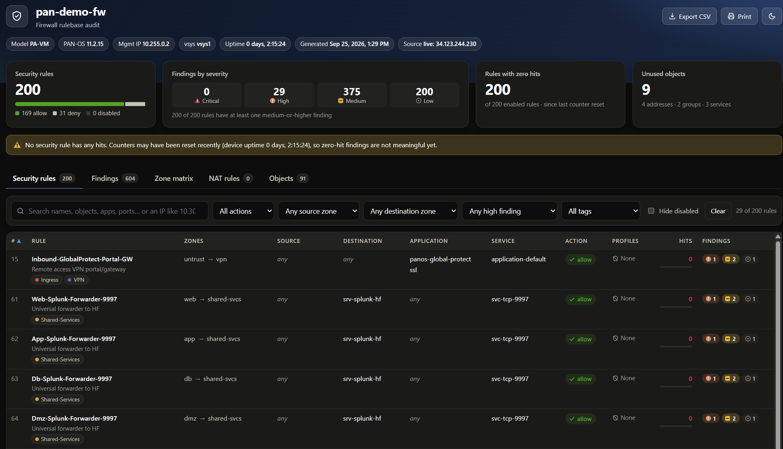
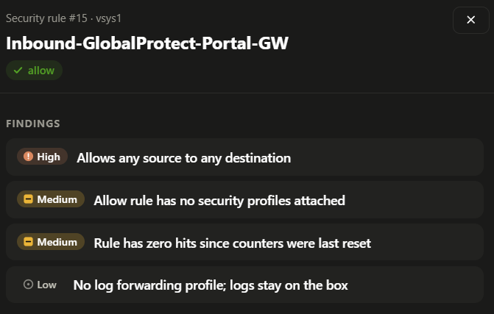
1
Risk: none · offline copies
The “Single File HTML App” Pattern
Notes:
9:00–10:00. Walk the screenshot: device list, search, then the Issues view with severities. Point out one finding the room will recognize. Placeholder until the real screenshot is added.

Slide 11
2
Risk: none to production · lab only
A working lab from one prompt
On-prem: Containerlab
Cloud: Terraform
Switches, routers and firewalls as containers or VMs.
Try out Azure Virtual WAN, or AWS Transit Gateway, or ...
PROMPT
PROMPT
Build a Containerlab topology: 2 spines and 4 leafs on cEOS, eBGP underlay, EVPN, and two Linux hosts in VLAN 10. Include startup configs so it works on first boot.
Write Terraform for an Azure Virtual WAN with two hubs and three spoke VNets, tagged for cost tracking. Then give me the destroy command. Include guidance on required permissions/auth.
Cloud labs cost money while they run, but they are generally really cheap if run for minutes/hours. Use automation for fast spin up/down.
KNOW
CHANGE
PROVE
REACT
GOVERN
SERVE
Lab / twin
Notes:
10:00–11:30. Containerlab runs vendor images too: cEOS, SR Linux and FRR as containers, and router and firewall VMs through vrnetlab. On the cloud side, the point is speed of learning: try a vWAN or Transit Gateway design in an afternoon instead of a quarter. Tag everything and destroy when done. This lab is also where you rehearse step 5.

Slide 12
3
Risk: low · read-only account
Configs in git, on a schedule
Backup and history for free. Each night's configs are a commit; what changed, and when, is a git diff.
network-state/
├── inventory.yml what to collect
├── collect.py read-only, nightly
├── configs/
│ ├── dc1/dc1-leaf1a.cfg
│ ├── campus/hq-idf1.cfg
│ └── fw/hq-fw01.xml
└── tests/ step 4
A read-only service account, its password in the pipeline's secret store. Scrub secrets before commit.
Short Script AI writes with you: Netmiko, Scrapli, or vendor APIs.
The input for steps 1 and 4. Your app and your tests now run on fresh data.
KNOW
CHANGE
PROVE
REACT
GOVERN
SERVE
Collection
Notes:
11:30–13:00. The first automation that touches production, and it only reads. The service account gets a read-only role on every device. Run it from a scheduled pipeline (GitHub Actions, GitLab CI, Jenkins) or cron. Keep the repo private. Firewalls: pull the config export over the vendor API. This repo becomes the foundation for everything after it.

Slide 13
4
Risk: none · offline copies
Network unit tests on your backups
Outage from a bad port config? Write a test that finds it anywhere.
# tests/test_bpduguard.py
from pathlib import Path
def test_access_ports_have_bpduguard():
missing = []
for cfg in Path("configs").rglob("*.cfg"):
for intf in cfg.read_text().split("\ninterface ")[1:]:
name, _, body = intf.partition("\n")
body = body.split("\n!")[0]
if "mode access" in body and "bpduguard" not in body:
missing.append(f"{cfg.stem} {name}")
assert not missing, missing
Governance rule? Every new firewall rule needs a ServiceNow ticket in its description.
Nightly, on step 3's backups. Failures go to a Teams Workflows webhook.
Still zero risk: offline and read-only. Let AI write the code for the tests.
KNOW
CHANGE
PROVE
REACT
GOVERN
SERVE
Compliance
Security policy
Notes:
13:00–15:00. One file per test, run with pytest on a schedule against the configs folder from step 3. This test is real: it finds IOS-style access ports without BPDU guard. The firewall version: a regex for a ServiceNow change number (CHG followed by digits) in each new rule's description. Notifications: start with a Teams Workflows webhook (Microsoft is retiring the older connector webhooks); add ServiceNow or email later. Every incident should leave a test behind.

Slide 14
AI Safety for “Writes”
1
AI writes code; people review the code and approve changes
2
Prove it in the lab first
3
Capture state before and after (and stop when the diff is wrong)
4
Start small: one device or HA pair, in a change window, with a human go/no-go.
5
Use AGENTS.md & detailed specifications (outsource coding not architecture)
Notes:
15:00–16:00. The line between steps 1–4 and 5–6. Everything so far was read-only. From here the automation changes devices, so the Prove family moves to the front. AGENTS.md tells an AI agent the rules; branch protection, CI and credential scope are what actually stop a bad change.

Slide 15
5
Risk: medium · writes one device or pair
Automated Upgrades
1
2
3
4
5
→
→
Upgrade standby, then peer
→
→
Capture state
Pre-checks
Capture again
Diff
Not just the clicks: capture all of this, before and after
EXAMPLE · hq-fw01 before after
BGP neighbors 4 4
Routes 1,212 1,212
Sessions 48,310 47,902
Interfaces up 22 21 ← check
Issue: ethernet1/7 is down.
Sessions
CPU & Memory
Route Table
ARP & MAC Tables
Interface Status
BGP & OSPF Neighbors
HA State
Version & Licenses
KNOW
CHANGE
PROVE
REACT
GOVERN
SERVE
Task scripts
Post-checks
Lifecycle
Notes:
16:00–18:30. Patching is constant now, so this pays back fast. The point: we aren't automating a few button clicks; we're automating the complete before-and-after state analysis that tells you the upgrade didn't break anything. Pre-checks: disk space, image hash, HA in sync, config saved. The state capture is read-only and reusable: run it before and after any change, not just upgrades. Rehearse in the step 2 lab. The numbers on screen are an illustrative example, not real data.

Slide 16
6
Risk: higher · writes the whole fleet
Network “Source of Truth”
1
2
3
4
5
Intent in Git
→
Render
→
Diff
→
Review & push
→
Verify
YAML, AVD model
configs + docs
vs running
PR + approval
post-checks
Drift found? The loop runs again.
More than this talk can cover. A source of truth is the foundation for full network automation. Start with Arista's AVD data model as a reference design: YAML in git.
KNOW
CHANGE
PROVE
REACT
GOVERN
SERVE
Source of truth
Declarative
Pre/post checks
Notes:
18:30–20:30. Say it plainly: more than I can get into in 30 minutes. A network source of truth is critical to automation at scale. If you don't know where to start on route/switch, use Arista's AVD data model as a reference design for a YAML data model in git. AVD can push it for you; or take only the data model and reconcile with your own software, which is what the reference repos do. Infrastructure as code isn't one box on the map: it's this chain of boxes. Note: the guidepost2026 repos are private until published; confirm before the talk.

Slide 17
Mapping this back to our model
Know
Change
Prove
React
Govern
Serve
Intent and reality
Make the change
Will it work? Did it?
Act on events
Stay in policy
Let others self-serve
Source of Truth
Task Automation
Pre-Change Validation
Event-Driven Remediation
Lifecycle & Risk
Self-Service
Step 6
Step 5
Step 5
Steps 2, 6
Diagnostic Automation
State Collection
Declarative Config
Security Policy
ChatOps
Step 3
Step 6
Post-Change Verification
Steps 1, 4
Zero-Touch Provisioning
Steps 5, 6
Next
Next
Docs & Reporting
Step 1
Compliance & Audit
Service Orchestration
Steps 1, 4
Notes:
20:30–22:00. Same map as slide 2, now lit up. Six steps touch four of the six families and ten of the fifteen boxes, and the first four steps never wrote to a device. What's left: event-driven remediation, diagnostics and self-service. Those are where agents will act on their own, and they need everything to their left first.

Slide 18
What could this look like, for you?
THIS WEEK -- 1–2
THIS MONTH -- 3–4
THIS QUARTER -- 5
WHEN READY -- 6
Build a config explorer from a few exports. Spin up a lab from one prompt.
Nightly config backups to git, read-only. Your first three unit tests, posting to Teams.
Automate one upgrade with a before-and-after state diff: lab first, then one HA pair.
Model one fabric in a source of truth, starting from AVD's data model.
Done when:
you trust AI on copies
Done when:
tests you trust run nightly
Done when:
a clean production upgrade
Done when:
the first fully automated change
Leaders: approve one AI tool for config work, a read-only service account, and a sandbox cloud subscription (with a budget).
Notes:
22:00–23:30. Steps 1 and 2 need nothing but an approved AI tool and an afternoon. Steps 3 and 4 need one read-only service account and a private repo. Step 5 needs a change window and the lab from step 2. Leaders unblock all of it with three approvals. Then open the floor.

Slide 19
Questions?
github.com/ae-business-solutions/guidepost2026-network-starter
network-starter on GitHub
Notes:
23:30–30:00. Leave this slide up for all of Q&A. Likely questions: which AI tool, and where does our config data go (precautions slide); security won't approve AI tools (steps 1–4 need only scrubbed copies); why AVD and not NetBox (NetBox fits multi-vendor inventory and IPAM, and can feed the same model); we're an Ansible shop (keep it: the map is tool-neutral); can an agent push changes itself (no: guardrail 1). The hidden appendix slides cover the reference repos if someone asks how step 6 works.

